Slide 1

Implementation of Technology
Student Resource
Presentation and application by…
Kaustabh Dutta B023
Mihir Gandhi B025
Aparajit Gupta B035
Tejas Jadhav B037

Slide 2
Idea of the app…
We have developed an app that will make a student’s life a bit easier.
The app will provide the students of any engineering college a list of books to refer throughout their 4 years course.
They may also view a list of teachers that are involved with the respective year and their corresponding courses.

Slide 3
Why to use this app?
Students in engineering colleges are very easily burdened with several books for each subject without having proper guidance on what to study for each subject and how to study for each test.
This app helps you overcome this burden and to get through the semesters easily.

Slide 4
How different is the app?
A similar app to this one is the mobile version of Blackboard.
What makes this app different is that it pinpoints the particular notes to be referred for each subject.
Also, it provides a list of all the faculty members for the various subjects so that it is easier for students to refer.
This app has a bit simpler interface than BB.
This app does not require internet connection.

Slide 5
Who can use this app?
Any student from our college (MPSTME) can refer to this app.
It can be used by any individual student of any engineering college since all the engineering colleges would have similar courses and they can modify this app accordingly.

Slide 6
Software Requirements of the app…
Phone
OS – 2.3(Gingerbread) and higher
Resolution – any
Java Support
Computer
OS – Any from among Linux/Microsoft/iOS
Software – Android Studio 1.0.1 or higher OR Eclipse IDE with ADT plug-in and SDK tools.

Slide 7
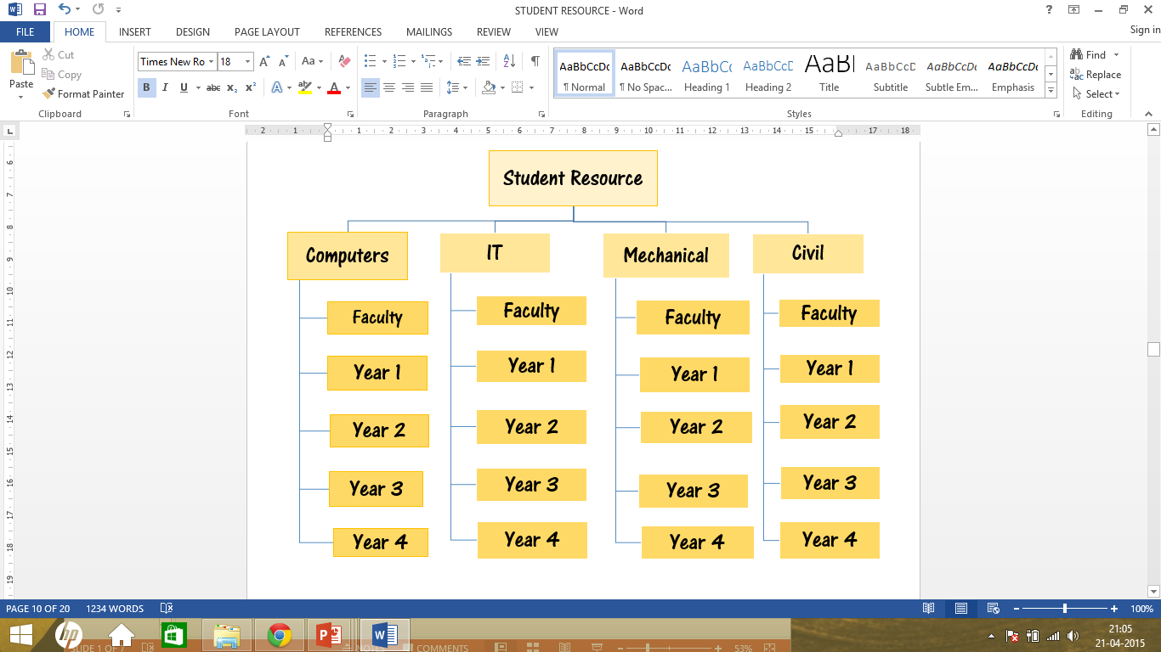
Flowchart of the app…

Slide 8
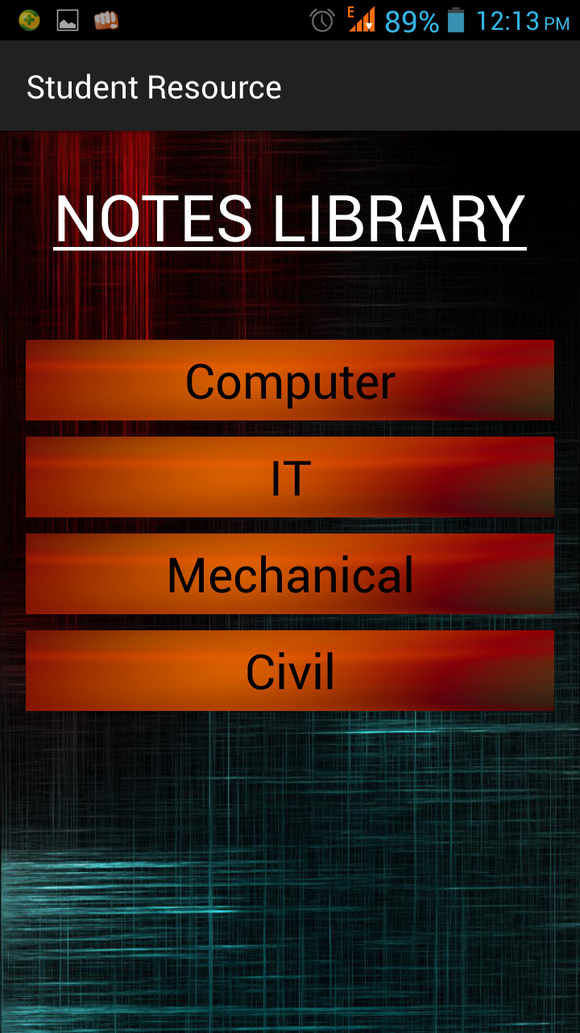
Home page of the app…

Slide 9
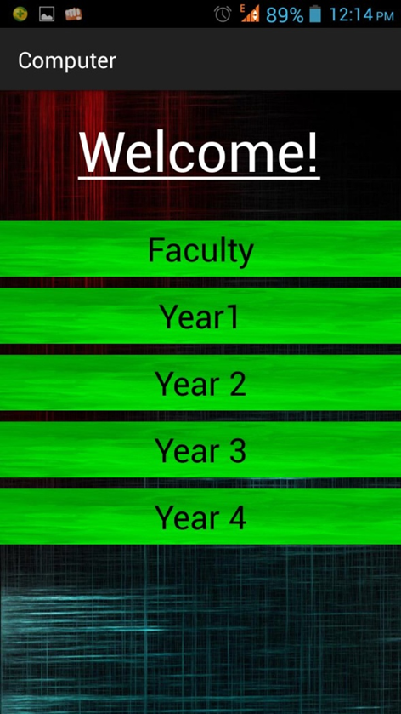
Computer page of the app…

Slide 10
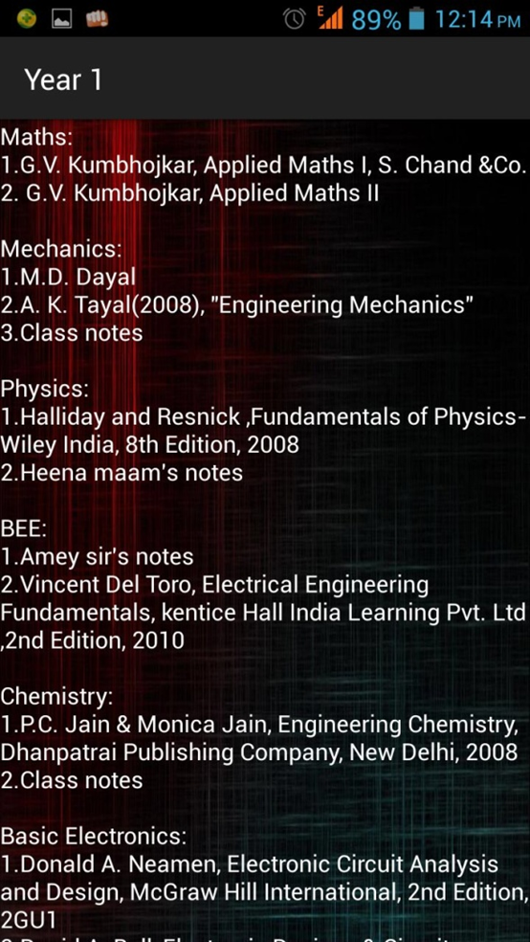
Year 1 page of the app…

Slide 11
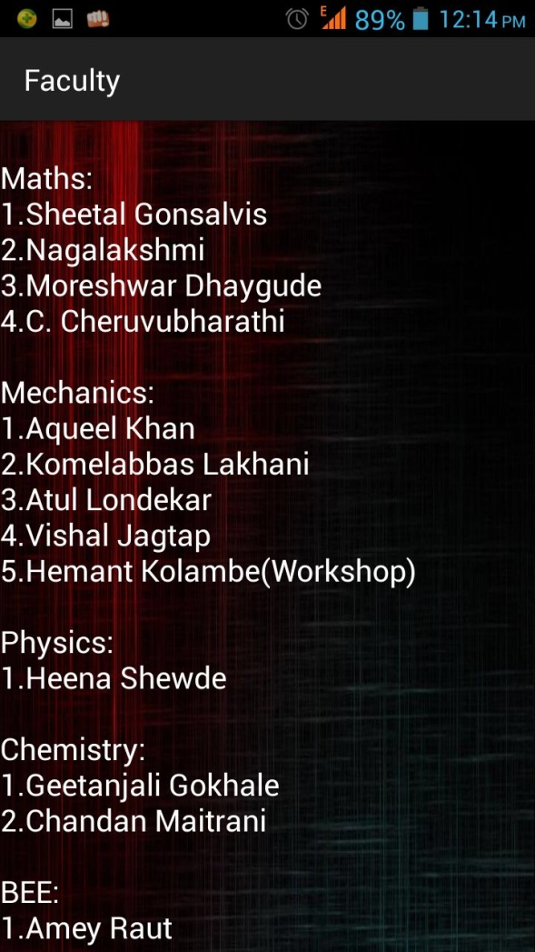
Faculty page of the app…

Slide 12
Limitations of App
It gives you just the list of the notes to be studied and does not provide with the actual notes.
However we can provide links to download the notes which would require internet connection.

Slide 13
Future scope of the app…
Since this app serves as a resource book, it is college limited. Thus, in future, colleges wanting to implement this app according to their curriculum can buy the proprietary rights and we will provide them with our source code so that they can modify it according to their needs.

Slide 14
Thank You! ☺

